Slide 1

Real Time Driver Drowsiness Detection based on Light-Weight CNN Architecture and Attention Mechanism -------------------------------------------------------------------------
Project Review - 1
Batch-8
Gottiprolu Saketh – 20KB1A3012
Daddolu Praveen – 20KB1A3010
Pavan Kumar – 20KB1A3027
Atmakuru Nithin – 20KB1A3005
Under the guidance of
Mrs. Swarna Latha
Department of IT AND AIDS,
N.B.K.R Institute of Science and Technology, Vidyanagar

Slide 2
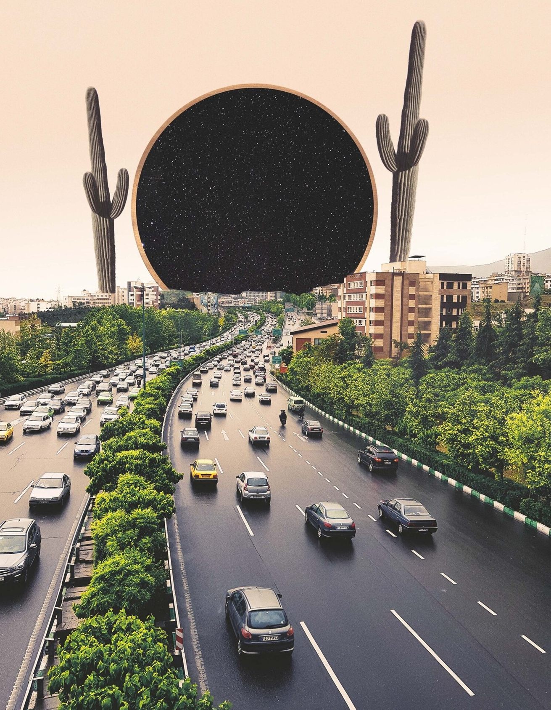
INTRODUCTION
In this presentation, we will explore Enhancing Driver Safety using a light- weight CNN approach with an attention mechanism. We will discuss the importance of driver safety and how CNN and attention mechanism can contribute to it.

Slide 3
LITERATURE SURVEY
YEAR | NAME | KEY POINTS | LIMITATIONS
2022 | Vision Transformers and YoloV5 based Driver Drowsiness Detection Framework. | A custom YoloV5 pre-trained model and self-trained ViT architecture are proposed for automated face extraction, and binary image classification The proposed system works on a single frame in detecting drowsiness. Hence, frames are extracted from the video dataset and serve as the framework’s input Accuracy: 96.2% on training set and 95.5% on test data | Requires high amount of data with labelled scene conditions for model to be trained Very large number of parameters are generated for ViT approx. 450 Million parameters for given configuration not suitable for edge devices

Slide 4
LITERATURE SURVEY
YEAR | NAME | KEY POINTS | LIMITATIONS
2020 | Deep self-attention network for facial emotion recognition. [ScienceDi- rect,Elsevier ] | The paper discusses the use of deep self-attention networks for facial emotion recognition, which can improve the accuracy of emotion detection. The authors propose a new method for facial emotion recognition that combines deep self-attention networks with other techniques to improve performance. Accuracy: around 77.78% on training data and 64.40% on test data. | The paper concludes that further research is needed to optimize the network architecture and improve the accuracy of facial emotion recognition.

Slide 5
LITERATURE SURVEY
YEAR | NAME | KEY POINTS | LIMITATIONS
2023 | Real-Time Deep Learning-Based Drowsiness Detection: Leveraging Computer-Vision and Eye-Blink Analyses for Enhanced Road Safety | Haar-Cascade is used to detect faces. Mediapipe model is used for locating landmarks. Drowsiness was solely determined by calculating landmark coordinates. Classification depends on facial landmarks and head position. 85% accuracy achieved when eyes and mouth closed. 96% when head leaning. | May not be relevant for drivers who wear sunglasses. Other objects may be present that interrupt the facial landmarks, the model may become confused when tracking and analyzing the state of the driver.

Slide 6
LITERATURE SURVEY
YEAR | NAME | KEY POINTS | LIMITATIONS
2021 | Light-weight Convolutional Neural Network for Distracted Driver Classification. | The proposed network uses a Global Average Pooling layer instead of Fully Connected layers, which significantly reduces the number of parameters in the network. The network is built on the advantages of Convolution and Depthwise Separable Convolution operation to extract important features. achieved an accuracy of 99.95% on the StateFarm dataset and 95.36% on the AUC dataset | evaluation of the proposed network was performed on only two datasets, and it is unclear how the network would perform on other datasets or in real-world scenarios. The proposed method may not be fully optimized for real-time applications at this time.

Slide 7
PARAMETERS -------------------------------------------------
Number of convolutional layers
Filter size and number
Activation functions
Attention mechanism
Learning rate
Input image size

Slide 8
METHODOLOGY
The proposed network architecture consists of the feature extractor and classifier modules.
The feature extractor module is designed based on the stem module, adaptive connections (AC), and a CBAM to extract the feature maps.
At the final feature map, the classifier module applies a GAP and a softmax function to calculate the probability of three driver states and then classifies them.

Slide 9
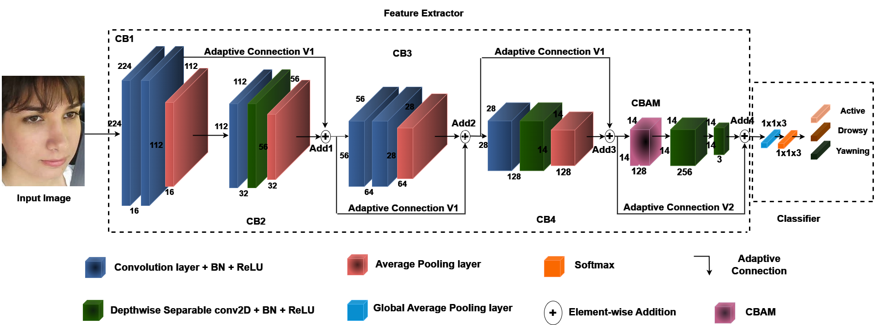
ARCHITECTURE
Figure: Light weight CNN with Attention module.

Slide 10
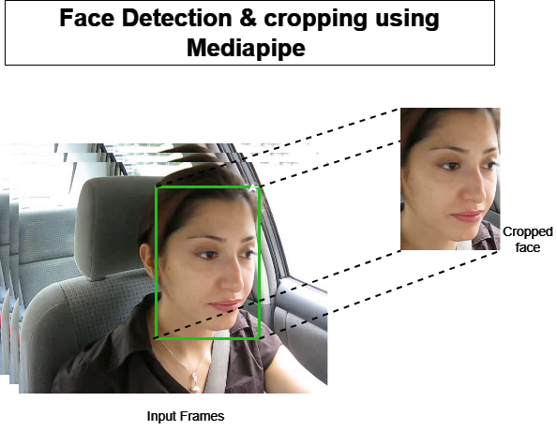
Implementation procedure -----------------------------------------
1)Pre-Processing: Face detection and cropping::
Using MediaPipe’s capabilities, face detection within images and subsequently crop the detected face regions to focus on the facial features.

Slide 11
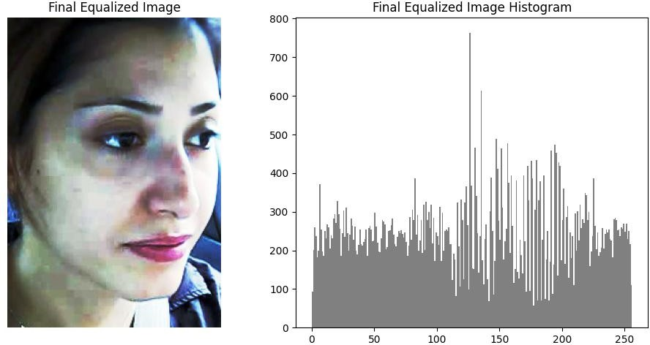
2)Histogram Equalization::
Histogram equalization was used to enhance the contrast of an image and to improve visibility by redistributing the intensity values in the histogram.
Figure: Final image after doing histogram equalization along 3 color(R,G,B) channels.

Slide 12
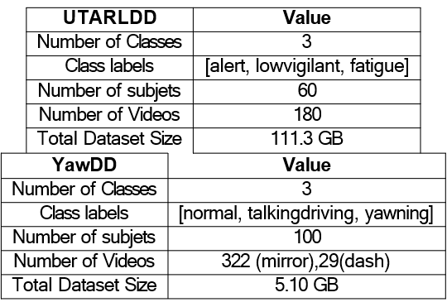
Datasets Information ----------------------------------------

Slide 13
Expected Results ----------------------------------
Accurate model
Generalizability
Latency i.e less than 30 millisec

Slide 14
Results Analysis ----------------------------------

Slide 15
Conclusion ----------------------------------
This project will be presenting a robust solution for real-time driver drowsiness detection leveraging a lightweight convolutional neural network architecture augmented with an attention mechanism. Through extensive experimentation on a diverse dataset, the proposed model demonstrated promising performance in accurately identifying drowsiness states of drivers.

